Slide 1
Wireless Networks

Slide 2
Basic Wireless Communication System

Slide 3
Components of Wireless Communication System

Slide 4
Signal
Signal - physical representation of data
Mathematically, a signal is represented as a function of time – or can be expressed as a function of frequency
Any electromagnetic signal can be shown to consist of a collection of sinusoids at different amplitudes, frequencies, and phases (Fourier Series or Transform)
Communication systems perform the tasks of
– Signal generation
– Signal transmission
– Signal reception
– Signal detection

Slide 5
Wireless Communication
wireless communication
Basically the study of how signals travel in the wireless medium
To understand wireless networking, we first need to understand the basic characteristics of wireless communications
How further the signal can travel
How strong the signal is
How much reliable would it be (how frequently the signal strength vary)
Indoor propagation
Outdoor propagation and
Many more…
Wireless communication is significantly different from wired communication

Slide 6
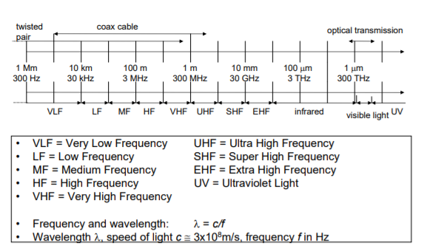
Frequencies for communication

Slide 7
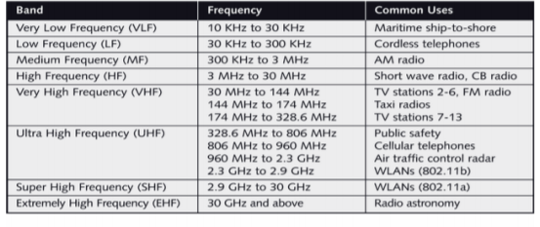
Frequencies and their use

Slide 8
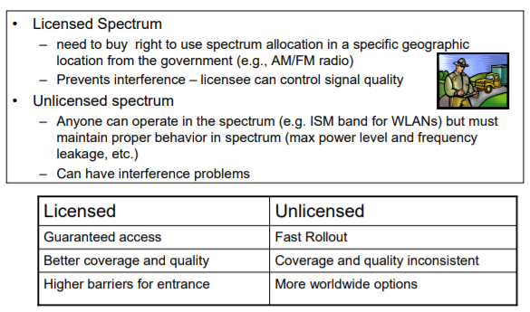
Licensed vs Unlicensed spectrum

Slide 9
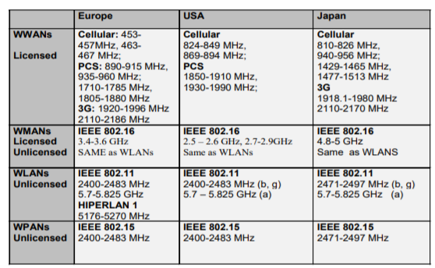
Frequency Allocation

Slide 10
Wireless signal propagation
Signal Propagation describes how a radio signal is transformed from the time it leaves a transmitter to the time it reaches the receiver
Wireless transmissions propagate in three modes. They are −
Ground-wave propagation
Sky-wave propagation
Line-of-sight propagation

Slide 11
Signal Propagation
Ground wave propagation: At low frequency (below approximately 3 MHz) due to diffraction, radio waves can travel as ground waves, which follow the contour of the Earth
Scattered in such a way that they do not penetrate the upper atmosphere
Example: AM radio

Slide 12
Signal Propagation
Sky wave propagation: Signal reflected from ionized layer of atmosphere back down to earth
Signal can travel a number of hops, back and forth between ionosphere and earth’s surface
Example: BBC radio
LOS: Above 30 MHz neither ground nor sky wave propagation operates, transmitting and receiving antennas must be within line of sight
Example: Satellite communication

Slide 13
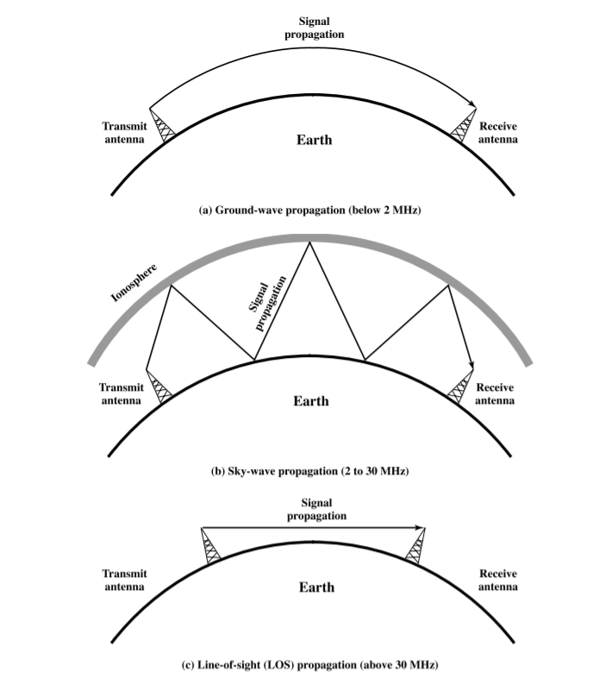

Slide 14
Path Loss
Reduction in power density of an electromagnetic wave or signal as it propagates through the environment in which it is travelling
Attenuation: The strength of signal falls with distance over transmission medium
Important for the design, operation and analysis of wireless networks
Where should transmitters (i.e., base stations/access points) be placed
What transmit powers should be used
the antennas, especially their gain, height and general location
Understanding radio coverage etc.

Slide 15
Wireless Propagation Models
Can be categorized into two types:
Large-scale propagation models
Small-scale propagation models
Large-scale propagation models
Propagation models that characterize signal strengths over Tx-Rx separation distance
Small-scale propagation models
Characterize received signal strengths varying over short scale
Short travel distance of the receiver
Short time duration

Slide 16
Large-scale propagation model
Also known as Path loss model
There are numerous path loss models
Free space path loss model
Simple and good for analysis
Mostly used for direct line-of-sight
Not so perfect for non-LOS but can be approximated
Ray-tracing model
2-ray propagation model
Site/terrain specific and can not be generalized easily
Empirical models
Modeled over data gathered from experiments
Extremely specific
But more accurate in the specific environment

Slide 17
Reasons for path loss
Free space loss: The free space loss occurs as the signal travels through space without any other effects attenuating the signal it will still diminish as it spreads out
Mostly used for direct line-of-sight
Not so perfect for non-LOS but can be
Reflection: occurs when the signal encounters a large solid surface, whose size is much larger than the wavelength of the signal, e.g., a solid wall.
Diffraction: occurs when the signal encounters an edge or a corner, whose size is larger than the wavelength of the signal, e.g., an edge of a wall.
Scattering : occurs when the signal encounters small objects of size smaller than the wavelength of the signal e.g. Trees, lamp-posts etc
Notes:
Free space loss: This can be thought of as the radio communications signal spreading out as an ever increasing sphere. As the signal has to cover a wider area, conservation of energy tells us that the energy in any given area will reduce as the area covered becomes larger
assumes a transmit antenna and a receive antenna to be located in an otherwise empty environment. Neither absorbing obstacles nor reflecting surfaces are considered.

Slide 18
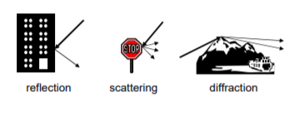
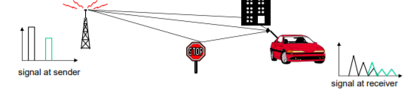
Multipath effect
Signal can take many different paths between sender and receiver due to reflection, scattering, diffraction
Time dispersion: signal is dispersed over time
interference with “neighbor” symbols, Inter Symbol Interference (ISI)
The signal reaches a receiver directly and phase shifted
distorted signal depending on the phases of the different parts
Limits the data rate on the channel

Slide 19
Free space Path Loss Model
What is the general principle?
The received power decays as a function of Tx-Rx separation distance raised to some power
i.e., power-law function
Path loss for unobstructed LOS path
Power falls off :
Proportional to d²

Slide 20


Free space Path Loss Model (contd.)
For Isotropic antenna
For Isotropic antenna
This equation is also known as Friis Equation
G_{t} and G_{r} are the transmitter and receiver antenna gains

Slide 21
Free space Path Loss (contd.)
What is the path loss?
Represents signal attenuation

Slide 22
Path Loss in dB
It is difficult to express Path loss using transmit/receive power
Can be very large or
Very small
Expressed as a positive quantity measured in dB
dB is a unit expressed using logarithmic scale
Widely used in wireless
With unity antenna gain,

Slide 23
Example
Consider Design of a Point-toPoint link connecting LANs in separate buildings across a freeway
– Distance .25 mile=400 m
– Line of Sight (LOS) communication
– Spectrum Unlicensed – using 802.11b at 2.4GHz
– Maximum transmit power of 802.11 AP is Pt = 24dBm
– The minimum received signal strength (RSS) for 11 Mbps operation is -80 dBm
– Will the signal strength be
adequate for communication?

Slide 24
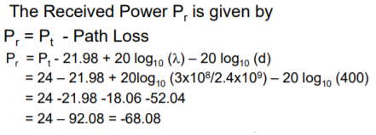
Example (Cont..)
Pr is well above the required -80 dBm for communication at the maximum data rate – so link should work fine

Slide 25
Assignment
What will be the order of path loss for a FM radio system that transmits with 100 kW with 50 km range?
Also calculate: what will be the order of path loss for a Wi-Fi radio system that transmits with 0.1 W with 100 m range?

Slide 26
Path Loss Model Generalized
In reality, direct LOS may not exist in urban areas
Free space Path Loss model is therefore generalized
n is called the Path Loss exponent
Indicates the rate at which the Path Loss increases with distance d, obstructions in the path, surrounding environment
The worse the environment is the greater the value of n

Slide 27
Path Loss Exponents for different environments
Environment | Path Loss Exponent, n
Free space | 2
Urban area cellular radio | 2.7 – 3.5
Urban area cellular (obstructed) | 3 – 5
In-building line-of-sight | 1.6 – 1.8
Obstructed in-building | 4 – 6
Obstructed in-factories | 2 – 3

Slide 28
Noise
Thermal Noise: is generated as a result of thermal agitation of the charge carriers which are typically electrons within an electrical conductor.
This thermal noise actually occurs regardless of the applied voltage because the charge carriers vibrate as a result of the temperature
Intermodulation noise – occurs if signals with different frequencies share the same medium
Interference caused by a signal produced at a frequency that is the sum or difference of original frequencies
Impulse noise – irregular pulses or noise spikes
Short duration and of relatively high amplitude
Caused by external electromagnetic disturbances, or faults and flaws in the communications system
Primary source of error for digital data transmission

Slide 29
Modulation
Process of encoding information from a message source in a manner suitable for transmission
Modulation can be done by varying certain characteristics of carrier waves according to the message signa
A desirable modulation scheme provides low bit error rates at low received signal to noise ratios

Slide 30
Advantage of modulation
Facilitates multiple access: By translating the baseband spectrum of signals from various users to different frequency bands, multiple users can be accommodated within a band of the electromagnetic spectrum
Increases the range of communication: Low frequency baseband signals suffer from attenuation and hence cannot be transmitted over long distances. So translation to a higher frequency band results in long distance transmission
Reduction in antenna size: The antenna height is inversely proportional to the radiated signal frequency and hence high frequency signal radiation result in smaller antenna size

Slide 31
Multiplexing
channels k_{i}
k₁
k₂
k₃
k₄
k₅
k₆
Multiplexing in 4 dimensions
space (s_{i})
time (t)
frequency (f)
code (c)
Goal: multiple use of a shared medium
Important: guard spaces needed!
c
t
c
s₁
t
s₂
f
f
c
t
s₃
f

Slide 32
Frequency multiplex
Separation of the whole spectrum into smaller frequency bands
A channel gets a certain band of the spectrum for the whole time
Advantages:
no dynamic coordination necessary
works also for analog signals
Disadvantages:
waste of bandwidth if the traffic is distributed unevenly
inflexible
guard spaces
k₁
k₂
k₃
k₄
k₅
k₆
c
f
t

Slide 33
Time multiplex
A channel gets the whole spectrum for a certain amount of time
Advantages:
only one carrier in the medium at any time
throughput high even for many users
Disadvantages:
precise synchronization necessary
k₁
k₂
k₃
k₄
k₅
k₆
c
f
t

Slide 34
Time and frequency multiplex
Combination of both methods
A channel gets a certain frequency band for a certain amount of time
Example: GSM
Advantages:
better protection against tapping
protection against frequency selective interference
higher data rates compared to code multiplex
but: precise coordination required
k₁
k₂
k₃
k₄
k₅
k₆
c
f
t

Slide 35
Code multiplex
Each channel has a unique code
All channels use the same spectrum at the same time
Advantages:
bandwidth efficient
no coordination and synchronization necessary
good protection against interference and tapping
Disadvantages:
lower user data rates
more complex signal regeneration
Implemented using spread spectrum technology
k₁
k₂
k₃
k₄
k₅
k₆
c
f
t

Slide 36
CDMA Example
D = rate of data signal
Break each bit into k chips
Chips are a user-specific fixed pattern
Chip data rate of new channel = kD
If k=6 and code is a sequence of 1s and -1s
For a ‘1’ bit, A sends code as chip pattern
<c1, c2, c3, c4, c5, c6>
For a ‘0’ bit, A sends complement of code
<-c1, -c2, -c3, -c4, -c5, -c6>
Receiver knows sender’s code and performs electronic decode function
<d1, d2, d3, d4, d5, d6> = received chip pattern
<c1, c2, c3, c4, c5, c6> = sender’s code

Slide 37
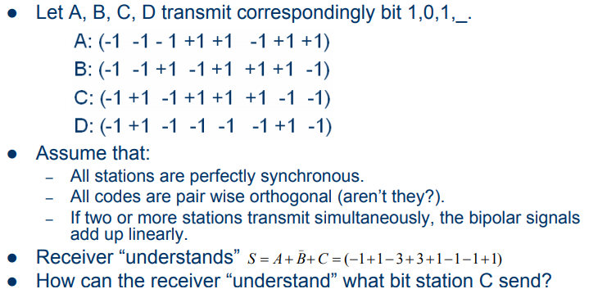
CDMA Example

Slide 38
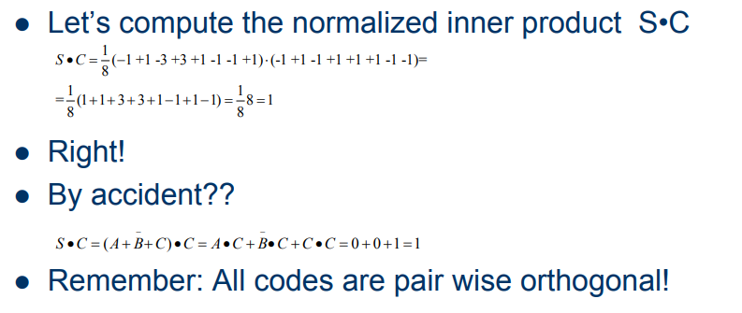
CDMA Example

Slide 39
Assignment
List out the disadvantages of CDMA

Slide 40
Class Assignment
5 channels, each with 100KHz are to be multiplexed. What is the minimum bandwidth of the link, if the guard band is 10KHz?
In a cellular system, first band 824 to 849 MHz for sending and 869 to 894 MHz for receiving. The 3KHz voice of a user is modulated using FM to 30KHz. How many people can use their phone simultaneously?
100*5 + 10* 4 = 540KHz
Each side is having 25MHz. 25MHZ/30KHz = 833.33. The band can have 833 channels (control channels are not considered)

Slide 41
Shannon’s Formula
The theoretical limit of the amount of data that a data channel can handle is given by the Shannon-Hartley theorem:
C = B log₂(1+S/N)
S=> Signal power
N=> Noise power
More bandwidth and the better the signal to noise ratio, the more bits per second you can push through a channel
SNR is large i.e. signal is strong (S/N >> 1)
C=.332 *B* SNR(in dB)
SNR is small i.e. signal is weak (S/N <<1)
C=1.44 * B.S/N

Slide 42
Shannon’s formula ( Example)
What is the Shannon-Hartley theoretical capacity for a signal with a frequency bandwidth of 1kHz, and a SNR = 200?
Answer: C = 1kHz * log₂ (1+200) = 1000 * 4.39 = 7651 bps
A 3 kHz voice signal which we wish to send through a channel with a noise level 100 times as powerful as the signal. What will be the required bandwidth?
Ans: 208KHZ, 70 times greater than the voice signal we wish to carry
Note: If we can find a way of encoding our data into a large signal bandwidth, then we can get error free transmission under conditions where the noise is much more powerful than the signal we are using.
Notes:
To send error-free information for a given signal-to-noise ratio in the channel, therefore, we need only perform the fundamental SS signal-spreading operation: increase the transmitted bandwidth

Slide 43
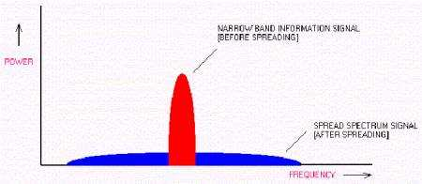
Spread Spectrum
“ spread of energy over a wide band”

Slide 44
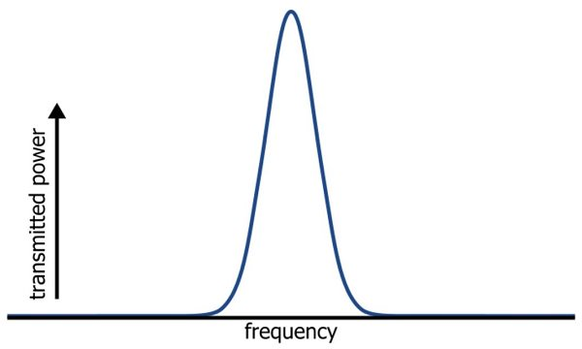
Spread Spectrum
Narrowband” signal: The band of frequencies covered by the signal is narrow

Slide 45
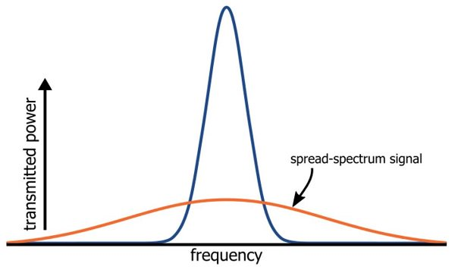
Spread Spectrum
Wideband Signal: Uses more bandwidth
Power density is very low.
Notes:
A narrowband signal can be modified in a way that increased the bandwidth while maintaining the same total transmitted power

Slide 46
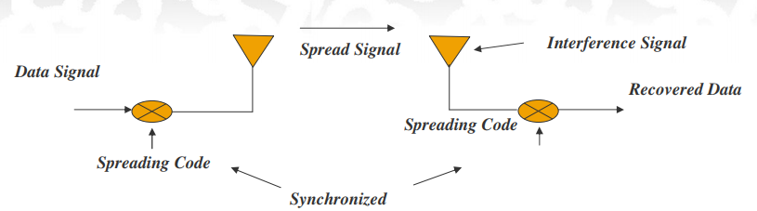
Spread Spectrum
Spread spectrum (SS) is a means of transmission in which:
The transmitted signal occupies a bandwidth which is much greater than the minimum necessary to send the information.
Spreading is accomplished by means of a spreading signal called a ‘code’ signal, which is independent of the data.
At the receiver, despreading is done by correlating the received SS signal with a synchronized replica of the spreading signal.

Slide 47
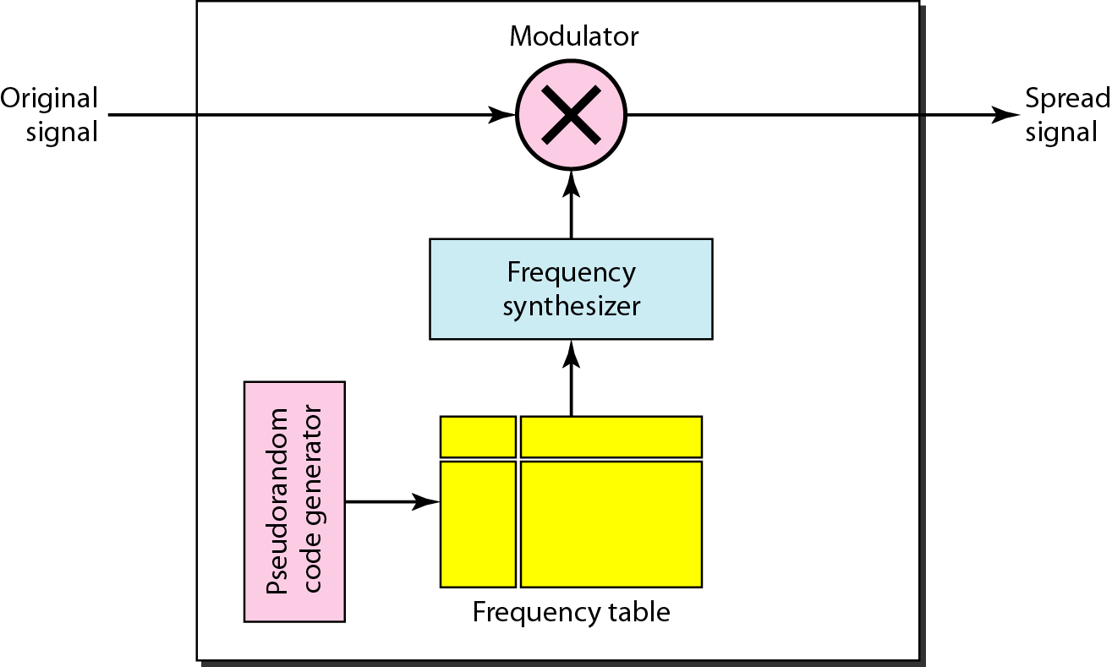
Types of Spread Spectrum
Frequency Hopping:
The information signal undergoes primary modulation (digital to analog) by PSK, FSK , which generates narrow band signal and secondary modulation with spread spectrum modulation.
This secondary modulation is modulation (frequency conversion) using a frequency synthesizer (hopping synthesizer) that changes the frequency with a random hopping pattern.
The spectrum is spread over a certain bandwidth, but in the moment of hopping, modulation is narrowband, and demodulation is also narrowband.
In appearance, the spectrum is spread over the specified bandwidth.

Slide 48
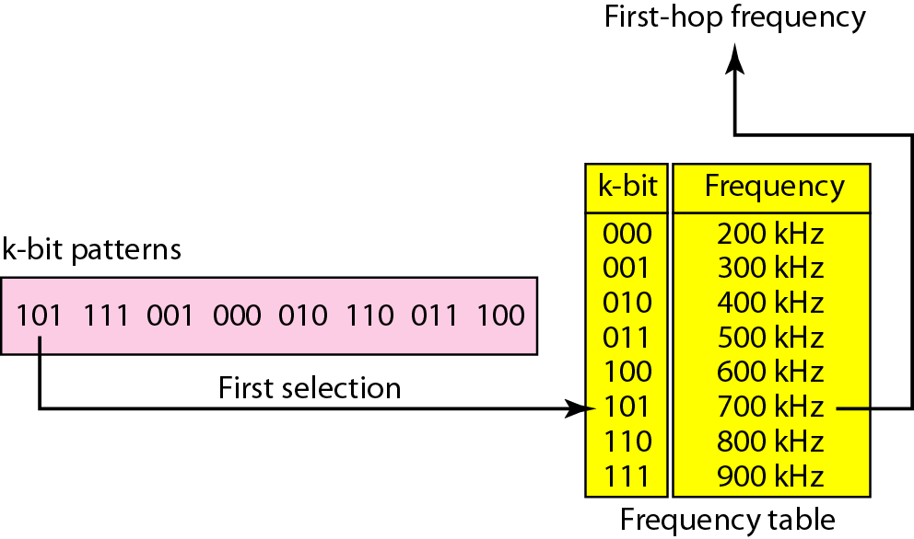
FHSS
Assume 8 hopping frequencies so k=3 bit pattern
Psuedo random generator will generate this pattern
This will be mapped to the frequencies
For 1 hopping period, the signal will remain to the one frequency

Slide 49
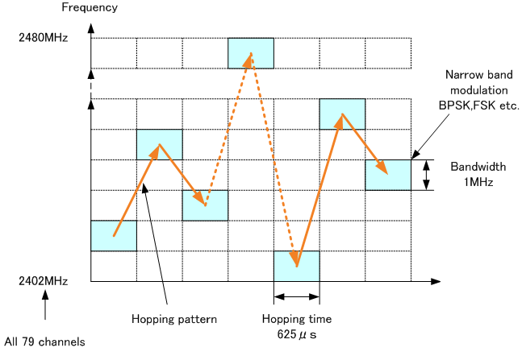
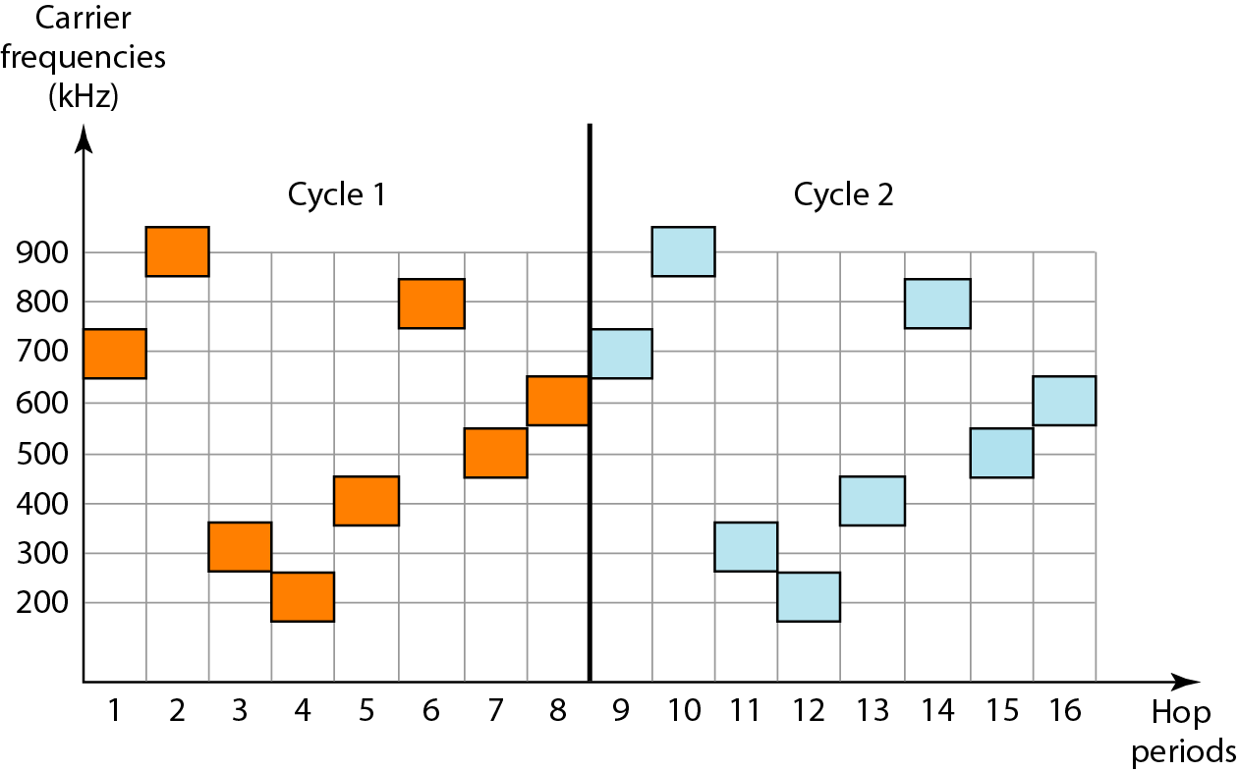
FHSS
FH is used in the Bluetooth system. In a total bandwidth of 79 MHz, the frequency band of a single frequency is 1 MHz. Frequency conversion is performed with a hopping pattern that changes with a speed of 1,600 times per second (625 μs). The primary modulation method is GFSK.

Slide 50
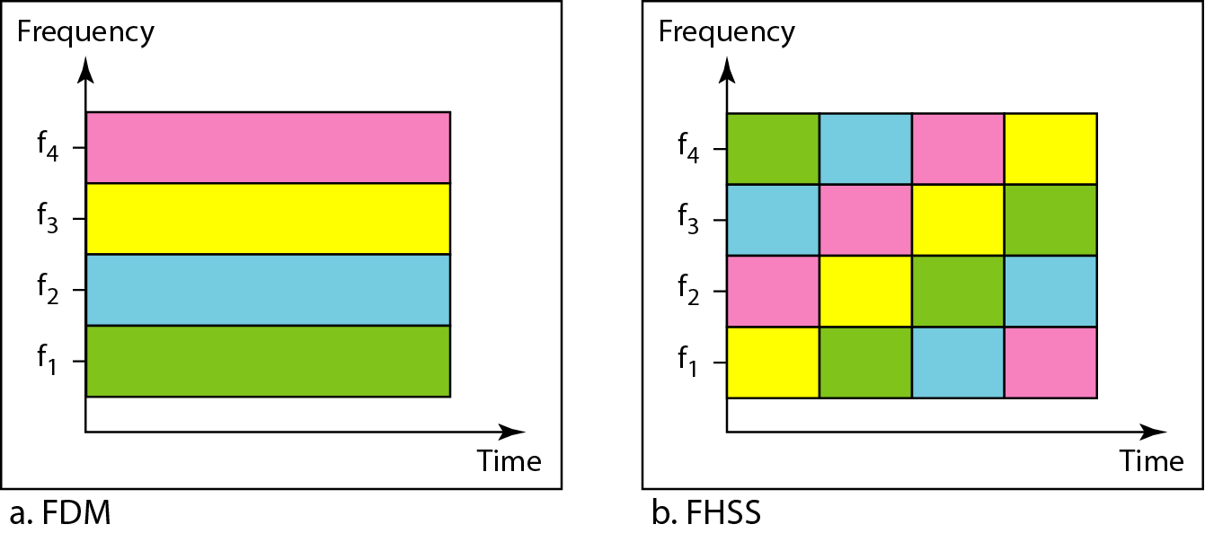
Frequency Sharing
Suppose we have bandwidth B and number of hopping channels as M
We have M users
FDM : Multiple users can use B by applying multiple FSK
Each user will use 1/M of the bandwidth and the allocation is fixed
FHSS : Each user will use 1/M of the bandwidth and allocation changes from hop to hop

Slide 51
DSSS
Direct Sequence Spread Spectrum: are obtained by multiplying the primary modulated signal and the square wave, called the PN sequence
Used by wireless LAN and ZigBee
This method generates a redundant bit pattern for each bit to be transmitted. This bit pattern is called a chip
The longer the chip, the greater the probability that the original data can be recovered, and the more bandwidth required

Slide 52
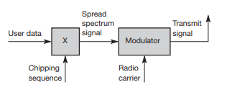
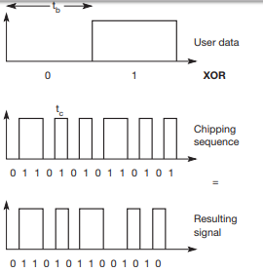
DSSS
Spreading factor s = t_{b}/t_{c} determines the bandwidth of the resulting signal
civil applications use spreading factors between 10 and 100, military applications use factors of up to 10,000
example a user signal with a bandwidth of 1 MHz. Spreading with the 11-chip would result in a signal with 11 MHz bandwidth. The radio carrier then shifts this signal to the carrier frequency (e.g., 2.4 GHz in the ISM band). This signal is then transmitted.

Slide 53
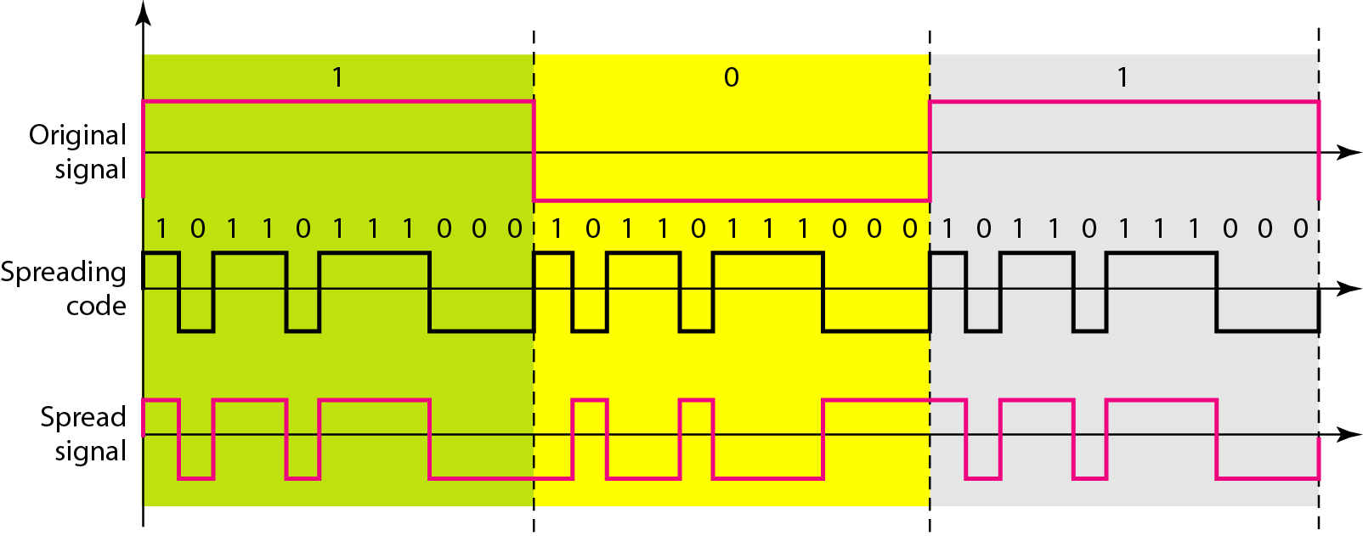
DSSS
Processing gain = (Pseudorandom chip rate)/(data rate)

Slide 54
Example
Consider a spread spectrum transmitter. Let d(t) be a binary sequence 1101 arriving at a rate of 100 bps, where left most bit is the earliest bit. Let c(t) be the pseudorandom binary sequence 100110111000 with a clock rate rate of 300 Hz. Assuming a bipolar signaling scheme with a binary ‘0’ and binary ‘1’ represented by a signal levels ‘-1’ and ‘+1’, respectively. Answer:
The final transmitted binary sequence corresponding to the bipolar signal sequence
The bandwidth of the transmitted spread signal is
The processing gain in dB
Assuming that the spread signal is not corrupted by noise, suppose the estimated delay at a spread spectrum receiver is too large by one chip time, the despread and decoded signal sequence (assuming majority logic decoding)
The number of bit errors
Notes:
https://nptel.ac.in/courses/117105136/Week%201%20Assignment%20Solution.pdf

Slide 55
Example
d(t): 1101 x(t): +1 +1 -1 +1
c(t): 100110111000
g(t): +1 -1 -1 +1 +1 -1 +1 +1 +1 -1 -1 -1
Spread sequence, p(t) = x(t)g(t):
x(t): +1 +1 +1 +1 +1 +1 -1 -1 -1 +1 +1 +1
g(t): +1 -1 -1 +1 +1 -1 +1 +1 +1 -1 -1 -1
p(t): +1 -1 -1 +1 +1 -1 -1 -1 -1 -1 -1 -1
Binary sequence corresponding to p(t): 100110000000

Slide 56
Example
Bandwidth of the transmitted spread signal (DSSS) is same as clock rate of the pseudorandom binary sequence (= 300 Hz)
Processing gain = (Pseudorandom chip rate)/(data rate)=300/100 = 3 = 10log(3) dB = 4.77 dB
Despread sequence, (p(t))(delayed g(t)) =
p(t): +1 -1 -1 +1 +1 -1 -1 -1 -1 -1 -1 -1
g’(t): -1 +1 -1 -1 +1 +1 -1 +1 +1 +1 -1 -1
r(t): -1 -1 +1 -1 +1 -1 +1 -1 -1 -1 +1 +1
Majority logic decoding (taking 3 bits at a time) yields: 0001
The number of bit errors due to the estimation delay is: the no. of bit errors in the decoded sequence is 2

Slide 57
Advantages of spread spectrum
Robustness against narrow band interference
Relatively high security
Coexistence of several signals – the receiver can separate each user based on code
No need of frequency planning as all user uses same BW
Wide band signals – less prone to interference

Slide 58
Cellular Network Evolution
CN Evolution from multiple user schemes: We want to accommodate large number of users
First Generation:
Launched in Mid 80’s
Purely analog
Voice Traffic only
FDMA/FDD Multiple access
AMPS (Advanced Mobile Phone Systems)

Slide 59
Second Generation System (2G)
Ex.-Global System for Mobile Communication
Digital Modulation (GMSK- the Gaussian minimum shift keying)
multiple access they used TDMA FDMA and CDMA
Data rate: 10Kbps
900Mhz/1800Mhz

Slide 60
CDMA Example
User A code = <1, –1, –1, 1, –1, 1>
To send a 1 bit = <1, –1, –1, 1, –1, 1>
To send a 0 bit = <–1, 1, 1, –1, 1, –1>
User B code = <1, 1, –1, – 1, 1, 1>
To send a 1 bit = <1, 1, –1, –1, 1, 1>
Receiver receiving with A’s code
(A’s code) x (received chip pattern)
User A ‘1’ bit: 6 -> 1
User A ‘0’ bit: -6 -> 0
User B ‘1’ bit: 0 -> unwanted signal ignored

Slide 61
Path Loss Example
Consider Wi-Fi signal in this building. Assume power at a reference point d₀ is 100mW. The reference point d₀=1m. Calculate your received signal strength at a distance, d=100m. Also calculate the power received in mW. Assume n=4.
This is a typical Wi-Fi received signal strength.

Slide 62
Indoor Propagation Model
The indoor radio channel differs from the traditional mobile radio channel in outdoor
Distances covered are much smaller
Variability of the environment is much greater
Propagation inside buildings strongly influenced by specific features
Layout and building type
Construction materials
Even door open or closed
Same floor or different floors
Partition Losses

Slide 63
Partition Losses
Partition Losses
Same floor
Between floors
Characterized by a new factor called Floor Attenuation Factors (FAF)
Based on building materials
FAF mostly empirical (computed over numerous tests)
For example,
FAF through one floor approx. 13 dB
Two floors 18.7 dB
Three floors 25 dB and so on…

Slide 64
Cellular Model (signal to interference)
From the propagation model,
Let’s combine today’s concept with last week’s cellular concept
Let’s find out signal to interference
In a cellular radio system with 7-cell reuse pattern and a 6 co-channel interferers, what is the signal to interference in dB? Assume Path loss exponent = 4.
Q: co-channel
Reuse ratio
m co-channel
interferer
Cell radius R
Co-channel
interferer distance D_{i}

Slide 65
Numerical example (signal to interference)
In a cellular radio system, the required signal to interference must be at least 15 dB. What should be the cluster size (N) if Path loss exponent = 3. Assume 6 co-channel interferers.
Soln hint: Let’s assume N =7
To convert it to dB,
do 10log(16.04) = 12.05 dB
This is still less than reqd 15 dB.
So we need to use a larger N. Try for next feasible N.

Slide 66

Mobile Radio Propagation: Small scale fading
What is small-scale fading?
In contrast to large-scale propagation we studied so far
Small-scale fading describe rapid fluctuation of the signal over
short period of time and/or
short travel distance
P_{r}
P_{t}
v
d=vt

Slide 67
Factors influencing small-scale fading
Multipath propagation
Interference between two or more versions of the transmitted signal
Arrive at the receiver at slightly different times
Speed of the Mobile
Relative motion between Base Station and the mobile
Signals travel varying distances
Speed of the surrounding objects
Typically this can be ignored if the obstacles are fixed
May not be so in a busy urban area

Slide 68
dBm and dBW
dBm and dBW are other two variations of dB
dB references two powers (Tx and Rx)
dBm expresses measured power referenced to one mW
Particularly applicable for very low received signal strength
dBW expresses measured power referenced to one watt
dBm Widely used in wireless
P in mW
In a wireless card specification, it is written that typical range for IEEE 802.11 received signal strength is -60 to -80 dBm. What is the received signal strength range in terms of watt or mW?

Slide 69
Relationship between dB and dBm
What is the relationship between dB and dBm?
In reality, no such relationship exists
dB is dimensionless
dB is 10 log(value/value) and dBm is 10 log (value/1miliwatt)
However, we can make a quick relationship between dBm and dBW and use the concept wisely!

Slide 70
Back to Path Loss model
We saw Path loss expressed in dB
Note, the above eqn does not hold for d=0
For this purpose, a close-in distance d₀ is used as a reference point
It is assumed that the received signal strength at d₀ is known
Received signal strength is then calculated relative to d₀
For a typical Wi-Fi analysis, d₀ can be 1 m.

Slide 71
Back to Path Loss model (contd.)
The received power at a distance d is then
In dBm,

Slide 72
Numerical example
If a transmitter transmits with 50 W with a 900 MHz carrier frequency, find the received power in dBm at a free space distance of 100 m from the transmitter. What is the received power in dBm at a free space distance of 10 km?

Slide 73
Assume that SNR(dB) is 36 and the channel bandwidth is 2 MHz. Calculate the theoretical channel capacity. Output2 : SNR(dB) = 10 * log₁₀(SNR) SNR = 10^{(SNR(dB)/10)} SNR = 10^{3.6} = 3981
Hence, C = 2 * 10⁶ * log₂(3982) = 24 MHz

